Slide 1



Commonly Used GoF Design Patterns
Presenting to: Opus Consulting Solutions
15-Feb-2024
Anand Kane

Slide 2


Agenda
Introduce the audience to SOLID principles and the below GoF design patterns
Composite
Visitor
State
Takeaways from the session
Understand SOLID principles
Get working knowledge of the above patterns
Be able to spot the abstractions and code to abstractions
Be able to write maintainable and extensible software components

Slide 3
SOLID principles
SOLID is an acronym for the first five object-oriented design (OOD) principles.
These principles help in writing maintainable and extensible software components.
The five principles are
Single Responsibility Principle: A class should do one thing and therefore it should have only a single reason to change.
Open-Closed Principle: Classes should be open for extension and closed to modification.
Liskov Substitution Principle: Subclasses should be substitutable for their base classes.
Interface Segregation Principle: A class should not be forced to implement methods that are not relevant to them. Interfaces should be as discret as possible in terms of the functinality they abstract.
Dependency Inversion Principle: Classes should depend on abstractions (Interfaces) instead of concrete implementations.
https://www.freecodecamp.org/news/solid-principles-explained-in-plain-english/
Notes:
Please use these blocks and resize as per your need . Do not alter colours and thickness

Slide 4
Assignment
Assuming that you are developing software for a residential society, you are given the below requirements.
A society has one or more buildings
Each building has one or more flats
Society, Building, and Flat have names
Flat has memberCount
Objective is to write the code to print member count for the society.
Ensure that
the code is extensible to accommodate new requirements
the code uses proper abstractions
the code implements encapsulation properly
Notes:
Please use these blocks and resize as per your need . Do not alter colours and thickness

Slide 5
Composite Design Pattern
Composite pattern is a Structural design pattern.
It lets you compose objects into tree-like structures to represent hierarchies.
It allows treating individual objects and compositions of objects (composites) uniformly.
The key concept is that you can perform operations on a single instance just as you would on a group of them.
Notes:
Please use these blocks and resize as per your need . Do not alter colours and thickness

Slide 6
Components of Composite Design Pattern
Component
Interface for components in the composition.
Defines operations for accessing and managing its child components.
Defines operations that are common for composites and individual components (leaf components).
Composite
A composite component is the one having child components, which can be either leaf components or other composites.
A composite class implements the methods declared in the Component interface, often by delegating the operations to its child components.
Notes:
Please use these blocks and resize as per your need . Do not alter colours and thickness

Slide 7
Components of Composite Design Pattern
Leaf
Defines behavior for primitive components in the composition.
This is the basic building block of the composition, representing individual components that don’t have any child components.
Leaf components implement the operations defined by the Component interface.
Client
Invokes operations on a composite using the component interface.
Notes:
Please use these blocks and resize as per your need . Do not alter colours and thickness

Slide 8
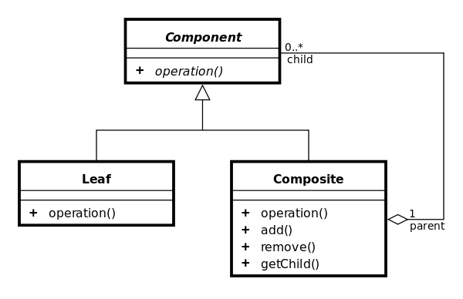
Composite Design Pattern Class Diagram
Notes:
Please use these blocks and resize as per your need . Do not alter colours and thickness

Slide 9
Visitor Design Pattern
Visitor design pattern is one of the behavioral design patterns.
It is used to perform an operation on a group of similar kind of Objects.
It allows to move operations performed on objects into separate class(es) facilitating Single Responsibility and Open Closed principles.
It can be used independently but is more often used along with Composite Design Pattern.
Notes:
Please use these blocks and resize as per your need . Do not alter colours and thickness

Slide 10
Components of Visitor Design Pattern
Visitor
Interface for all visitor classes.
Defines visit operations for all the types of visitable classes.
If used along with Composite, defines visit method for all implementations of Component interface of the composite.
Visitable
Interface which declares the accept operation.
This is the entry point which enables an object to be “visited” by the visitor object.
Client
Creates visitor instances and invokes accept method on the visitable object.
Notes:
Please use these blocks and resize as per your need . Do not alter colours and thickness

Slide 11
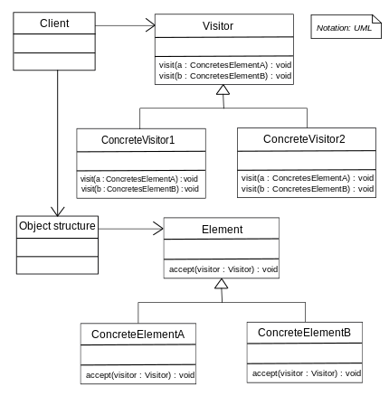
Visitor Design Pattern Class Diagram
Notes:
Please use these blocks and resize as per your need . Do not alter colours and thickness

Slide 12
State Design Pattern
The State design pattern is a behavioral design pattern.
It allows an object to alter its behavior when its internal state changes.
An object's behavior is a function of its state, and it must change its behavior at run-time depending on that state.
It allows to avoid complex and nested if-else and switch constructs.
Makes the code easily testable since the complex logic is broken down into different classes.
Notes:
Please use these blocks and resize as per your need . Do not alter colours and thickness

Slide 13
Components of State Design Pattern
Context: Object whose behavior changes based on its internal state. It maintains a reference to the current state. The Context provides an interface for clients to interact with and typically delegates state-specific behavior to the current state object.
State Interface: Interface that for all concrete state classes. This interface typically declares methods that represent the state-specific behavior that the Context can exhibit.
Concrete States: Concrete state classes implement the State interface or extend the base class. Each concrete state class encapsulates the behavior associated with a specific state of the Context. These classes define how the Context behaves when it is in their respective states.
Notes:
Please use these blocks and resize as per your need . Do not alter colours and thickness

Slide 14
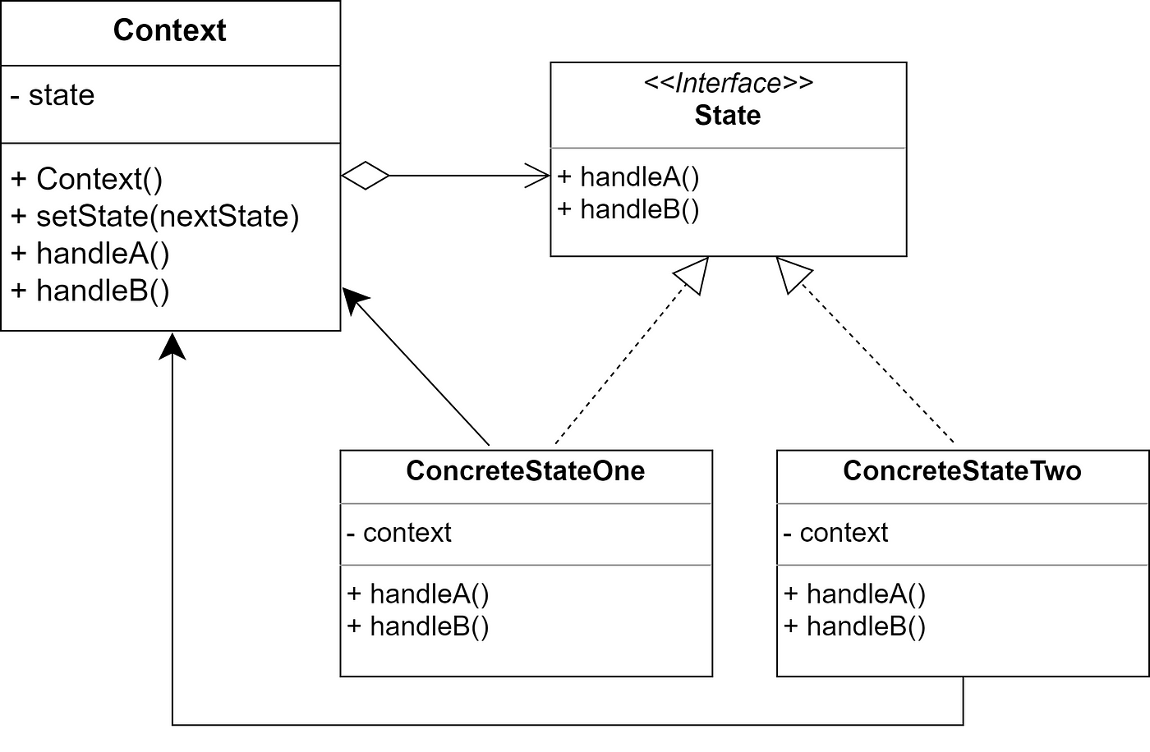
State Design Pattern Class Diagram
Notes:
Please use these blocks and resize as per your need . Do not alter colours and thickness

Slide 15



Q & A
Thank You.
2500 Northwinds Pkwy, Suite 630, Alpharetta 30009
@opusconsultingsolutions
https://www.opusconsulting.com/
@consultopus

